Slide 1
Calibrating a Scoring System for Data Breach Impact
Suzanne Widup
Russell Thomas
Senior Analyst, DBIR Co-Author
Verizon Enterprise Solutions
@SuzanneWidup
Principal Modeler for Cyber Risk
Risk Management Solutions (RMS)
@MrMeritology

Slide 2
Outline
Setting the sage
Theory and Method
Branching Activity
Indicators of Impact
Data sources & methods
Incorporating in VCD
Expert Scoring – round 1
Score Calibration
Co-occurrence and co-linearity
Linear regression to records disclosed
Constraint satisfaction
Inferences on evidence via BayesNet
Main Messages
Future Research: from Scores to $ Losses

Slide 3
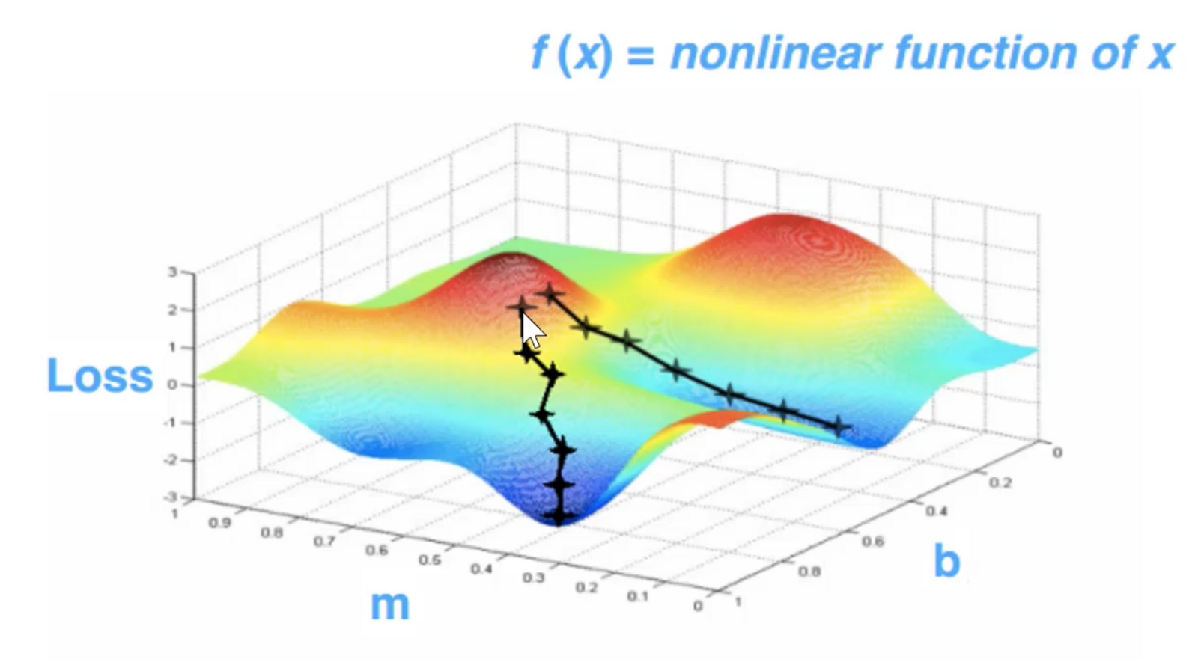
Organization Learning as Gradient Descent

Slide 4
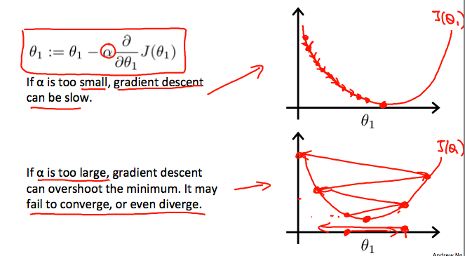
Organization Learning as Gradient Descent

Slide 5
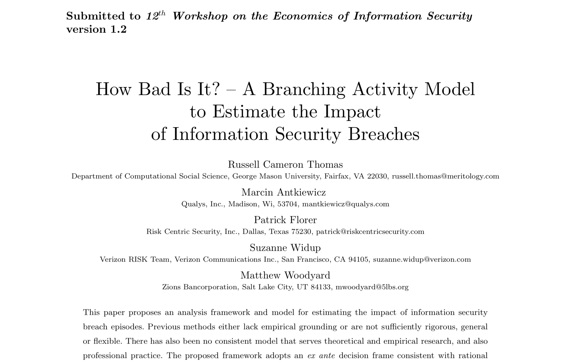
Theory and Method

Slide 6
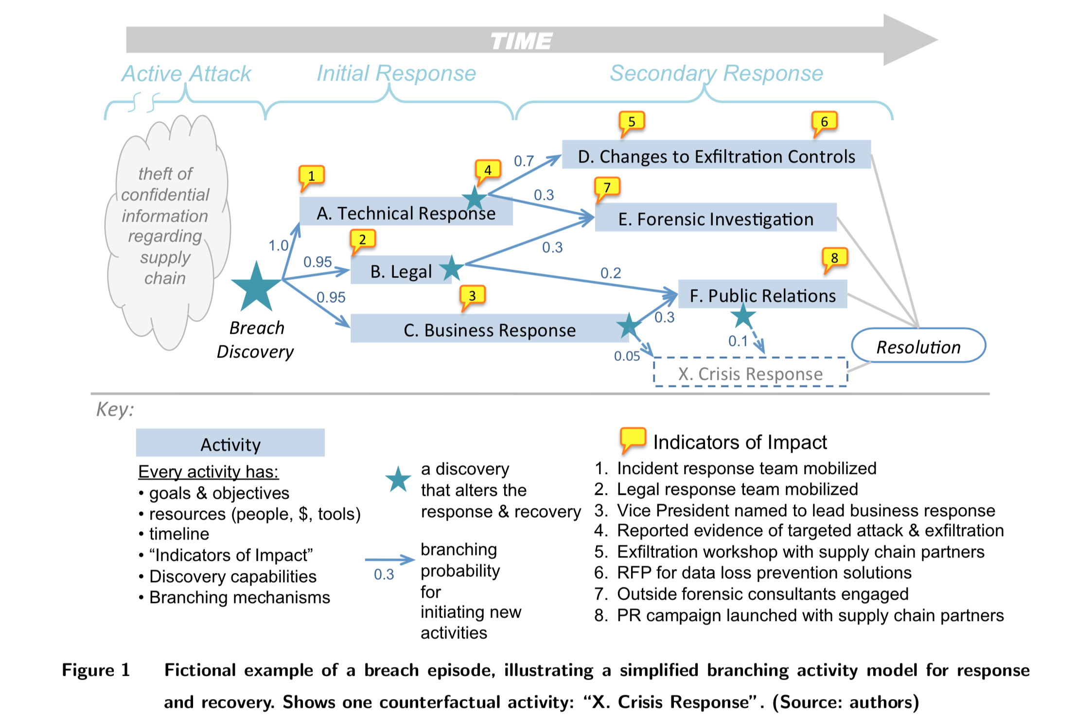

Slide 7
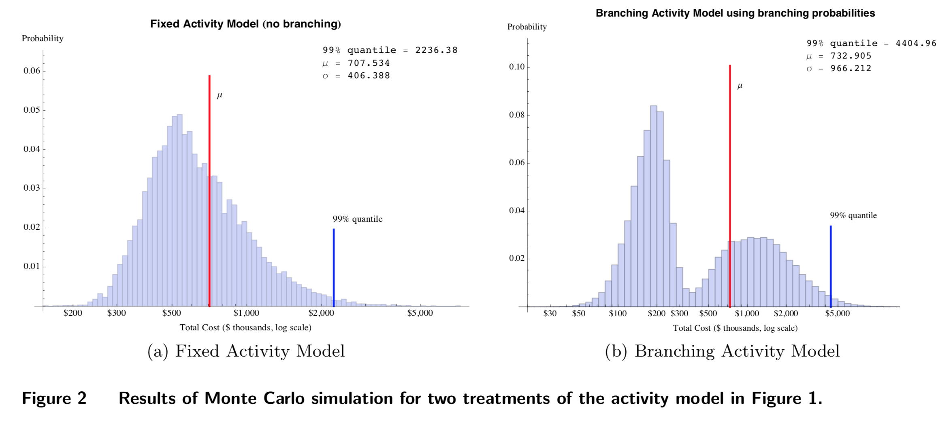

Slide 8
The Data
3,474 US incidents in the VCDB
2,738 had data about number of disclosed records
Hand coded based on publicly available information
Added to JSON in optional sections. Doesn’t depend on or change VERIS
42 Indicators of Impact, manually generated and revised in the course of coding the cases

Slide 9
Indicators of Impact (1 of 2)
Indicator | Weight | Indicator | Weight
10k/8k Language | 3 | Individual lawsuit(s) | 2
Business relationship ended | 3 | Industry oversight | 5
Class action lawsuit(s) | 3 | Intl jurisdictions affected | 5
Consent decree | 5 | Law enforcement action | 3
Enhanced data sensitivity | 3 | Legal settlements | 3
Executive churn | 3 | Legal settlements amount | NA
Extended media coverage | 2 | Loss of productivity | 3
Govt reporting required | 1 | Media coverage | 1
Govt testimony | 3 | Multiple domestic jurisdictions | 3
Increased security | 1 | New industry law | 4

Slide 10
Indicators of Impact (2 of 2)
Indicator | Weight | Indicator | Weight
New laws (not industry specific) | 5 | Over 1 thousand records disclosed | 2
Org bankruptcy | 6 | Partner bankruptcy | 4
Org extinction | 10 | Partner extinction | 5
Other monetary impact amt | NA | Poor IR handling | 3
Other monetary impact desc | NA | Poor IR handling description | NA
Over 1 million records disclosed | 5 | Regulatory fines | 3
Over 10 million records disclosed | 6 | Regulatory fines amount | NA
Over 100 million records disclosed | 7 | Single domestic jurisdiction | 1
Over 100 thousand records disclosed | 4 | Time sensitivity | 3
Over 10 thousand records disclosed | 3 | Under 1 thousand records | 1

Slide 11
Frequency of Indicators

Slide 12
Distribution of Record Loss

Slide 13
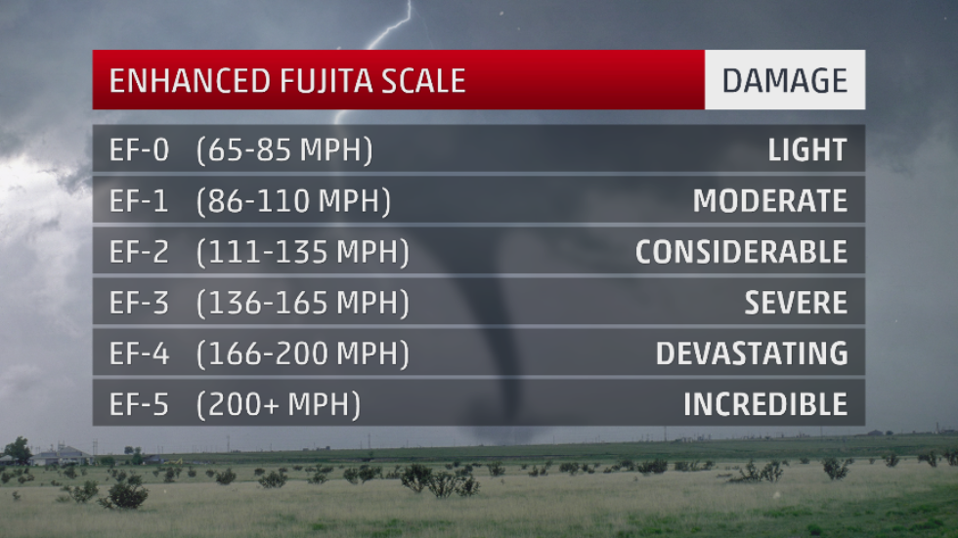
Idea: Breach Impact Scale for Lognormal or Power Law

Slide 14
Breach Impact Scale (1/3)
Scale Level | Score Range | Impact Description | Potential Characteristics
0 | 0-2 | Light Impact | Minimal media attention; low number of data victims; data involved not highly valued.
1 | 2-5 | Moderate Impact | Minimal media attention; over 1,000 data victims; data involved minimally monetizable.
2 | 5-7 | Considerable Impact | Single jurisdiction for litigation; potential for legal settlements or regulatory fines; data involved lucrative for financial crimes; number of data victims under 1 million.

Slide 15
Breach Impact Scale (2/3)
Scale Level | Score Range | Impact Description | Potential Characteristics
3 | 7-10 | Severe Impact | Class action litigation in single jurisdiction; multiple domestic jurisdictions for individual litigation; enhanced media coverage; regulatory fines and legal settlements; number of data victims under 1 million; data disclosed may have been highly sensitive
4 | 11-15 | Devastating Impact | Organization or partner extinction event for small organizations; bankruptcy protection may be sought for small orgs; class action litigation in multiple jurisdictions; international scope of breach; over 1,000,000 data victims.

Slide 16
Breach Impact Scale (3/3)
Scale Level | Score Range | Impact Description | Potential Characteristics
5 | 16-30 | Incredible Impact | Potential organization extinction event for medium sized organization; potential partner extinction event; significant resources for litigation; potential for new laws created affecting organization’s industry.
6 | 31+ | “Inconceivable” Impact | Potential organization extinction or near extinction event for large enterprise; significant disruption to normal operations; potential for new laws created affecting multiple industries.

Slide 17
Distribution of Impact Scores

Slide 18

Case Study #1

Slide 19

Case Study #2

Slide 20

Case Study #3

Slide 21


Case Study #4 LabMD

Slide 22
Case Study Summaries
 | EQUIFAX | MARRIOTT | YAHOO | LABMD
RECORDS | 146 million + | 500 million | 3 billion | 9,300
INDICATORS | 20/36 | 30/36 | 16/36 | 13/36
SCORE | 58 | 30 | 37 | 41
KNOWN COSTS | $439 million* | $28 million* | $830.3 million | ?
NOTES | New industry law, criminal prosecution, poor IR handling | Undiscovered for 4 years, calls for jailtime, potential for new laws | Multiple kinds of class actions, recent $50 million settlement rejected | Extinction event, continues to accrue litigation response costs
* minus insurance offset

Slide 23
Frequency of High Impact Breaches by Industry

Slide 24
Actions associated with High Impact Breaches

Slide 25
How You Might Use Impact Scores
Incorporate risk indicators into your IR planning
Incorporate impact scores into other risk calculations, especially for triage purposes.
Expand your incident response planning to account for relevant new risks
Improve communication with managers and executives beyond “high” – “medium” – “low” or $/record

Slide 26
Score Calibration via Explorations
Correlated / co-occurring / redundant indicators
Estimate weights directly – linear regression against # disclosed records
Adjust weights using constrained optimization
Inferences on evidence via BayesNet

Slide 27
1) Correlated / Co-occurring / Redundant Indicators
Simple: Correlation Matrix
Sophisticated: Iterated VIF
Correlated / Co-occurring / Redundant Indicators:
Node | Indicator | Weight
X6 | Executive churn | 3
X8 | Industry oversight | 5
X19 | Organization extinction | 10
X37 | Loss of Productivity | 3

Slide 28
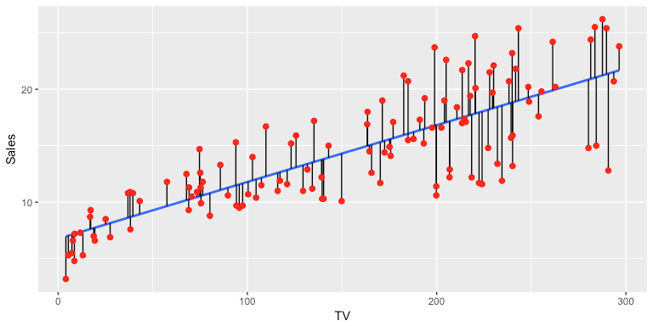
2) Linear Model for # Disclosed Records
Records = Intercept + (Weight₁ X Indicator₁) + (Weight₂ X Indicator₂) + …
Example:
2 variable
linear regression

Slide 29
Original Scores

Slide 30
New Scores

Slide 31
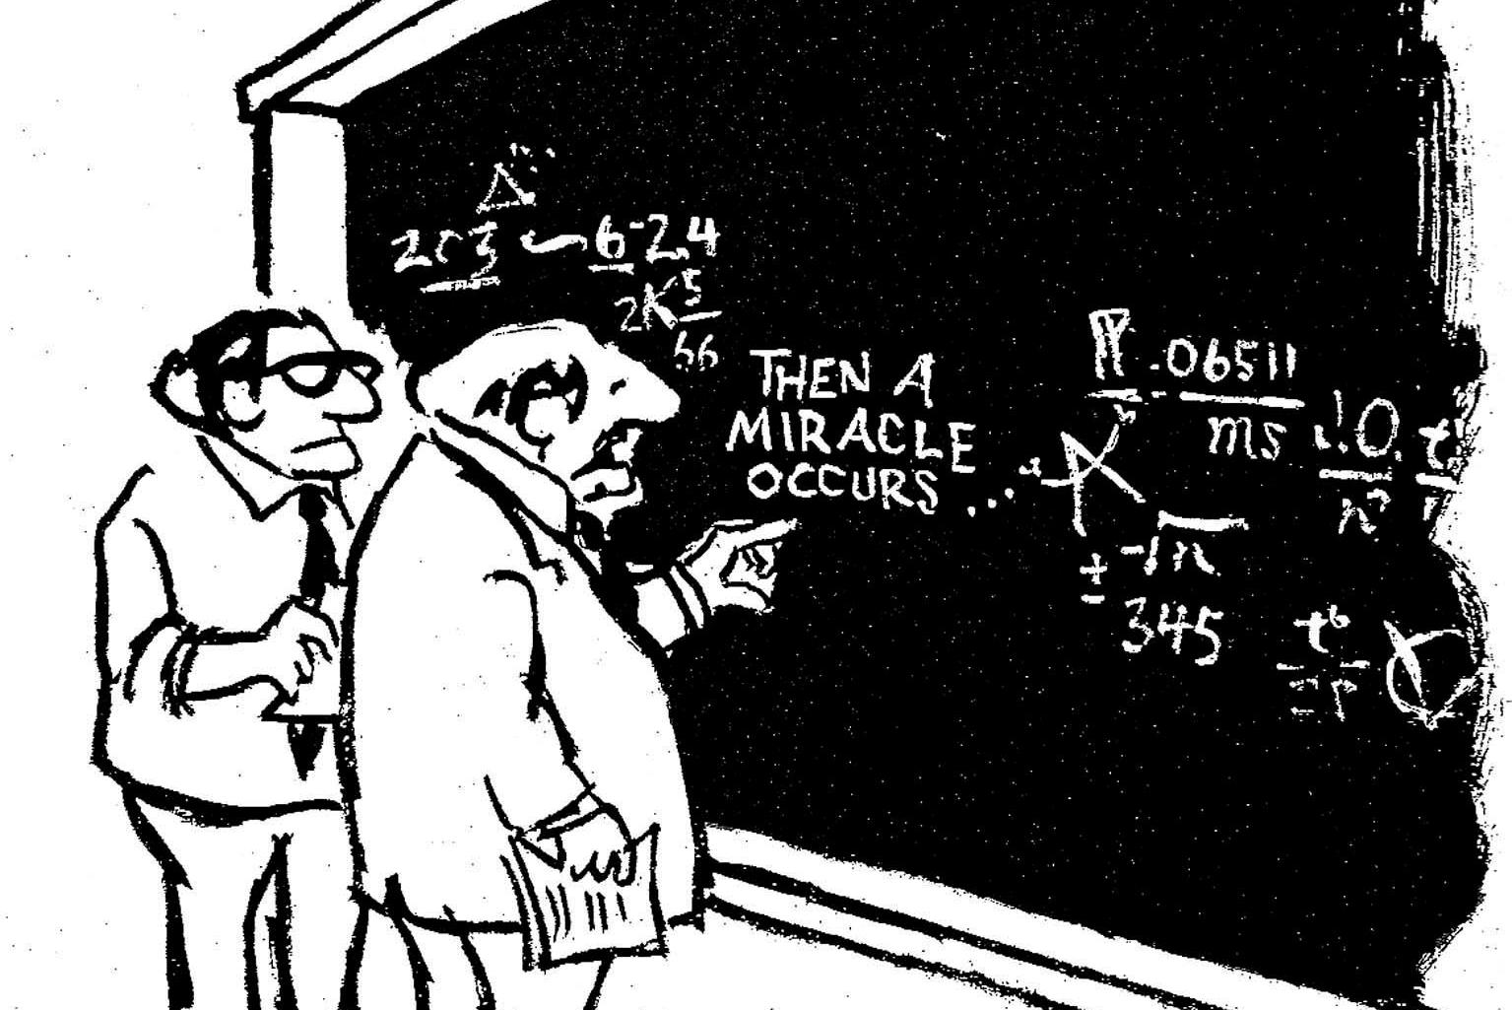

“Hmmm…problems…”

Slide 32
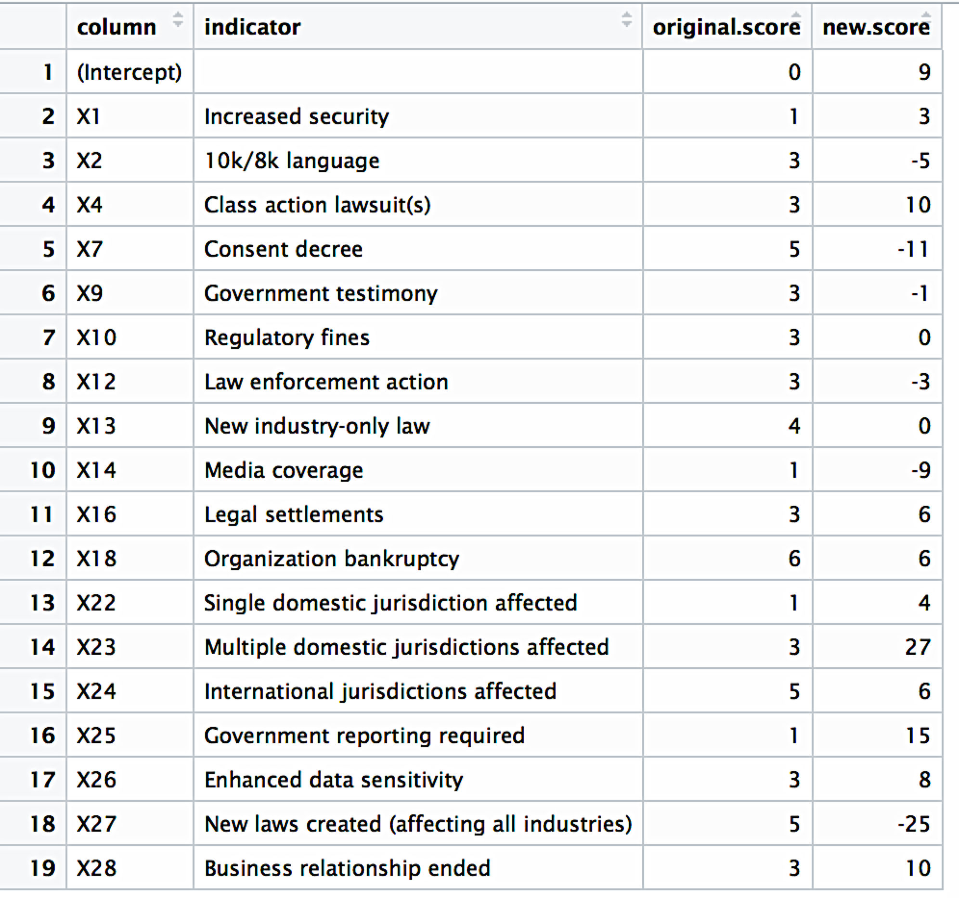
“…serious problems…”

Slide 33
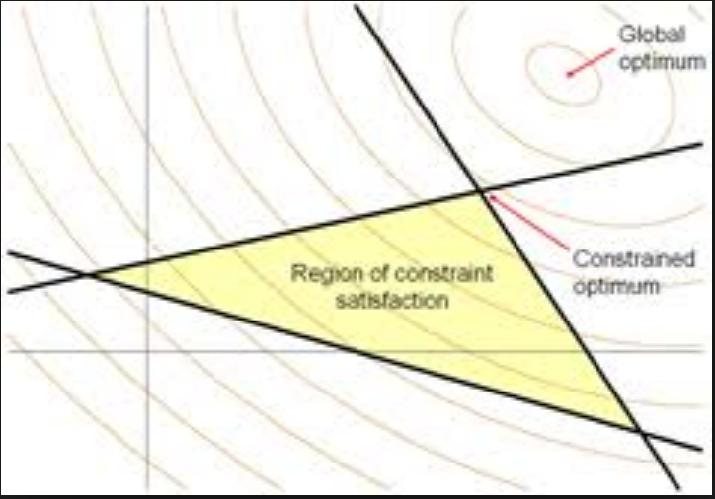
3) Constrained Optimization
Use existing weights as “initial condition”
Use “disclosed records” cases as constraints
<= upper limit
… yields 2,765 linear constraints
Function to maximize:
Sum of all weights
Gradient:
same small % increase to all relevant weights
Global
optimum
Constrained
optimum
Region of constraint
satisfaction

Slide 34
3) Constrained Optimization
Use existing weights as “initial condition”
Use “disclosed records” cases as constraints
<= upper limit
… yields 2,765 linear constraints
Function to maximize:
Sum of all weights
Gradient function:
same small % increase to all relevant weights
Global
optimum
Work In Progress:
Modifying Objective function
Contextualizing the Gradient
Constrained
optimum
Region of constraint
satisfaction

Slide 35
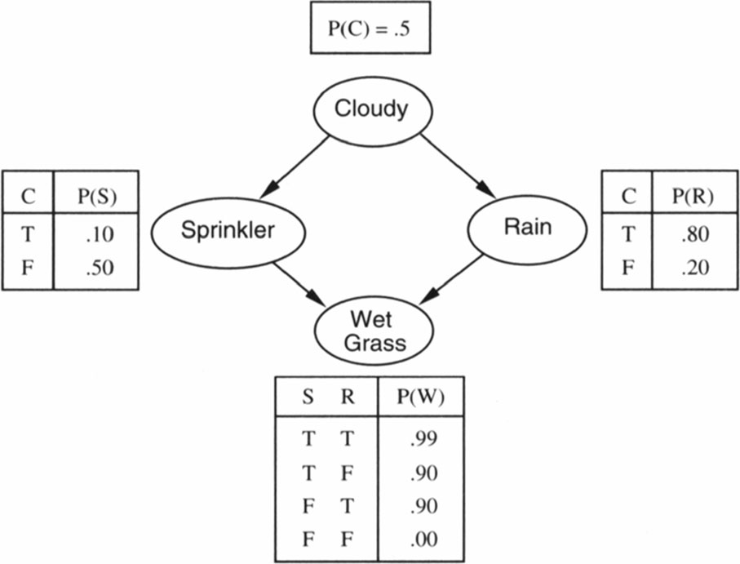
4) Inference on Evidence via BayesNet
Simple Example, with conditional probability tables

Slide 36
4) Inference on Evidence via BayesNet
Node | Indicator
X1 | Increased security
X2 | 10k/8k language
X3 | Individual lawsuit(s)
X4 | Class action lawsuit(s)
X5 | Time sensitivity
X6 | Executive churn
X7 | Consent decree
X8 | Industry oversight
X9 | Government testimony
X10 | Regulatory fines
X11 | Regulatory fines amount
X12 | Law enforcement action
X13 | New industry-only law
X14 | Media coverage
X15 | Extended media coverage
X16 | Legal settlements
X17 | Legal settlements amount
X18 | Organization bankruptcy
X19 | Organization extinction
X20 | Partner bankruptcy
X21 | Partner extinction
X22 | Single domestic jurisdiction affected
X23 | Multiple domestic jurisdictions affected
X24 | International jurisdictions affected
Node | Indicator
X25 | Government reporting required
X26 | Enhanced data sensitivity
X27 | New laws created (all industries)
X28 | Business relationship ended
X29 | Under 1k records disclosed
X30 | Over 1k records disclosed
X31 | over 10k records disclosed
X32 | Over 100,000 records disclosed
X33 | Over 1 million records disclosed
X34 | Over 10 million records disclosed
X35 | Over 100 million records disclosed
X36 | Over 1 billion records disclosed
X37 | Loss of Productivity
X38 | Other monetary impact amount
X39 | Other monetary impact description
X40 | IOI poor IR handling
X41 | IOI poor IR handling Description
X42 | Currency code

Slide 37
4) Inference on Evidence via BayesNet
Node | Indicator
X1 | Increased security
X2 | 10k/8k language
X3 | Individual lawsuit(s)
X4 | Class action lawsuit(s)
X5 | Time sensitivity
X6 | Executive churn
X7 | Consent decree
X8 | Industry oversight
X9 | Government testimony
X10 | Regulatory fines
X11 | Regulatory fines amount
X12 | Law enforcement action
X13 | New industry-only law
X14 | Media coverage
X15 | Extended media coverage
X16 | Legal settlements
X17 | Legal settlements amount
X18 | Organization bankruptcy
X19 | Organization extinction
X20 | Partner bankruptcy
X21 | Partner extinction
X22 | Single domestic jurisdiction affected
X23 | Multiple domestic jurisdictions affected
X24 | International jurisdictions affected
Node | Indicator
X25 | Government reporting required
X26 | Enhanced data sensitivity
X27 | New laws created (all industries)
X28 | Business relationship ended
X29 | Under 1k records disclosed
X30 | Over 1k records disclosed
X31 | over 10k records disclosed
X32 | Over 100,000 records disclosed
X33 | Over 1 million records disclosed
X34 | Over 10 million records disclosed
X35 | Over 100 million records disclosed
X36 | Over 1 billion records disclosed
X37 | Loss of Productivity
X38 | Other monetary impact amount
X39 | Other monetary impact description
X40 | IOI poor IR handling
X41 | IOI poor IR handling Description
X42 | Currency code
X14
X25
X14 Media Coverage
X25 Government reporting required

Slide 38
4) Inference on Evidence via BayesNet
Node | Indicator
X1 | Increased security
X2 | 10k/8k language
X3 | Individual lawsuit(s)
X4 | Class action lawsuit(s)
X5 | Time sensitivity
X6 | Executive churn
X7 | Consent decree
X8 | Industry oversight
X9 | Government testimony
X10 | Regulatory fines
X11 | Regulatory fines amount
X12 | Law enforcement action
X13 | New industry-only law
X14 | Media coverage
X15 | Extended media coverage
X16 | Legal settlements
X17 | Legal settlements amount
X18 | Organization bankruptcy
X19 | Organization extinction
X20 | Partner bankruptcy
X21 | Partner extinction
X22 | Single domestic jurisdiction affected
X23 | Multiple domestic jurisdictions affected
X24 | International jurisdictions affected
Node | Indicator
X25 | Government reporting required
X26 | Enhanced data sensitivity
X27 | New laws created (all industries)
X28 | Business relationship ended
X29 | Under 1k records disclosed
X30 | Over 1k records disclosed
X31 | over 10k records disclosed
X32 | Over 100,000 records disclosed
X33 | Over 1 million records disclosed
X34 | Over 10 million records disclosed
X35 | Over 100 million records disclosed
X36 | Over 1 billion records disclosed
X37 | Loss of Productivity
X38 | Other monetary impact amount
X39 | Other monetary impact description
X40 | IOI poor IR handling
X41 | IOI poor IR handling Description
X42 | Currency code
X23
X33
X22
X22 Single Jurisdiction Affected
X23 Multiple Jurisdictions Affected
X33 Over 1 million records disclosed

Slide 39
4) Inference on Evidence via BayesNet
Node | Indicator
X1 | Increased security
X2 | 10k/8k language
X3 | Individual lawsuit(s)
X4 | Class action lawsuit(s)
X5 | Time sensitivity
X6 | Executive churn
X7 | Consent decree
X8 | Industry oversight
X9 | Government testimony
X10 | Regulatory fines
X11 | Regulatory fines amount
X12 | Law enforcement action
X13 | New industry-only law
X14 | Media coverage
X15 | Extended media coverage
X16 | Legal settlements
X17 | Legal settlements amount
X18 | Organization bankruptcy
X19 | Organization extinction
X20 | Partner bankruptcy
X21 | Partner extinction
X22 | Single domestic jurisdiction affected
X23 | Multiple domestic jurisdictions affected
X24 | International jurisdictions affected
Node | Indicator
X25 | Government reporting required
X26 | Enhanced data sensitivity
X27 | New laws created (all industries)
X28 | Business relationship ended
X29 | Under 1k records disclosed
X30 | Over 1k records disclosed
X31 | over 10k records disclosed
X32 | Over 100,000 records disclosed
X33 | Over 1 million records disclosed
X34 | Over 10 million records disclosed
X35 | Over 100 million records disclosed
X36 | Over 1 billion records disclosed
X37 | Loss of Productivity
X38 | Other monetary impact amount
X39 | Other monetary impact description
X40 | IOI poor IR handling
X41 | IOI poor IR handling Description
X42 | Currency code
X4
X6
X4 Class Action Lawsuit
X6 Executive Churn
X18 Bankruptcy
X18

Slide 40
4) Inference on Evidence via BayesNet
Node | Indicator
X1 | Increased security
X2 | 10k/8k language
X3 | Individual lawsuit(s)
X4 | Class action lawsuit(s)
X5 | Time sensitivity
X6 | Executive churn
X7 | Consent decree
X8 | Industry oversight
X9 | Government testimony
X10 | Regulatory fines
X11 | Regulatory fines amount
X12 | Law enforcement action
X13 | New industry-only law
X14 | Media coverage
X15 | Extended media coverage
X16 | Legal settlements
X17 | Legal settlements amount
X18 | Organization bankruptcy
X19 | Organization extinction
X20 | Partner bankruptcy
X21 | Partner extinction
X22 | Single domestic jurisdiction affected
X23 | Multiple domestic jurisdictions affected
X24 | International jurisdictions affected
Node | Indicator
X25 | Government reporting required
X26 | Enhanced data sensitivity
X27 | New laws created (all industries)
X28 | Business relationship ended
X29 | Under 1k records disclosed
X30 | Over 1k records disclosed
X31 | over 10k records disclosed
X32 | Over 100,000 records disclosed
X33 | Over 1 million records disclosed
X34 | Over 10 million records disclosed
X35 | Over 100 million records disclosed
X36 | Over 1 billion records disclosed
X37 | Loss of Productivity
X38 | Other monetary impact amount
X39 | Other monetary impact description
X40 | IOI poor IR handling
X41 | IOI poor IR handling Description
X42 | Currency code
X6
Correlated/Co-occurring/Redundant Indicators:
X8
X6 Executive churn
X8 Industry oversight
X19 Organization extinction
X37 Loss of Productivity
X37
X19

Slide 41
Main Messages
Starting with a solid theoretical model is vital
Start with what you know and data you have. Use as stepping stones into the less-known and then unknown.
It’s OK to start with a crude, even erroneous metric if you have good “error signals” to guide learning and improvement.

Slide 42
Next Steps
Coping with unknown number of disclosed records
Analyze and code international incidents
different legal framework
Continue refining weights and scoring model, adding rigor
Begin to build Branching Activity Models linked to Indicators of Impact
Spin up the Monte Carlo Simulations!

Slide 43
Resources for More Information
VERIS Community Database Project: https://github.com/vz-risk/VCDB
Impact Scale Research Dataset: https://github.com/swidup/Breach-Impact-Scale
Case Study json:
Equifax: 957d1a6c-de24-41d0-8d09-d72157da4848.json
Yahoo: 7DA7CEC9-4052-4878-8EFA-44673719DAC6.json
Marriott: 160bd508-2d5d-435b-9e12-c58dd028ba6e.json
LabMD: 1F7FBF08-8CE3-4C08-A274-E62C7A07ED80.json

Slide 44
Questions?
Suzanne’s contact info:
Twitter: @SuzanneWidup
Email: suzanne.widup@verizon.com
Russell’s contact info:
Twitter: @MrMeritology
Email: russell.thomas@meritology.com
VERISDB:
Twitter: @VERISDB for running data breach feed as I find them

